Slide 1
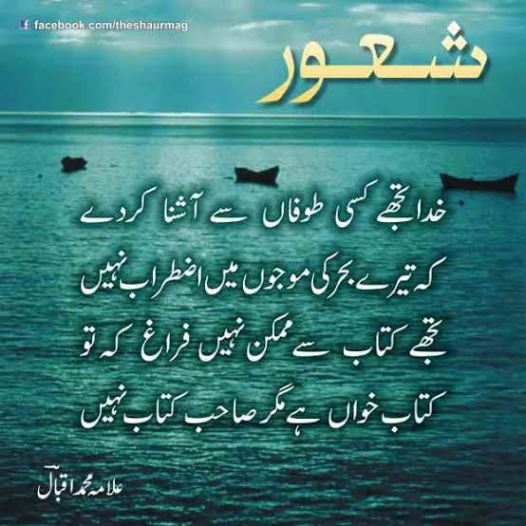
SOIL FORMATION A SEMINAR PRESENTED BY
SOIL FORMATION A SEMINAR REPORT BY
NAVEED HUSSAIN
Student of CIVIL ENGG.
AT SSMCOET
ENROLL 5362

Slide 2
CONTENTS
INTRODUCTION
OBJECTIVES
FACTORS AFFECTING SOIL FORMATION
SOIL FORMING PROCESSES
HUMAN FACTOR OF SOIL FORMATION
CONCLUSION

Slide 3
INTRODUTION
Soil formation is a long term process.
Formation of particular soil depends upon.
intensity
duration of weathering
climate & other parameters

Slide 4
OBJECTIVES
Soils are the product of weathering from some parent rock.
Basic objective is to understand the factors which are responsible for the formation of various kinds of soils

Slide 5
FACTORS AFFECTING SOIL FORMATION
JENNY STATE FACTOR EQUATION
S=F(C,O,R,P,T)
T= TIME;
O= ORGANISMS;
P= PARENT MATERIAL;
C= CLIMATE;
R= RELIEF (topography)
Pedogenesis

Slide 6
TIME
Younger soils could have some characteristics from parent material, but as they age ,the addition of organic matter and exposure to environment may change its feature ..
With time the soils change from one soil type to another.

Slide 7
PARENT MATERIAL
Determines the mineralogical composition.
The type of particular material also determines the rate at which soil forming process occurs .
Different places have different soils based on parent material.

Slide 8
CLIMATE
Climate especially
1)precipitation
2)temperature
3)frost action
has fundamental influence on soil formation

Slide 9
ORGANISMS
All living organisms like bacteria, fungi, animals etc. play an active role in soil formation.

Slide 10
FUNDAMENTAL SOIL FORMING PROCESSES
HUMIFICATION; Transformation of organic raw material into humus.
ELUVIATION;
Mobilisation & translocation of certain constituents viz.clay,Fe2o3,Al2o3,humus,CaCO3 & other salts etc. from one point of body to another

Slide 11
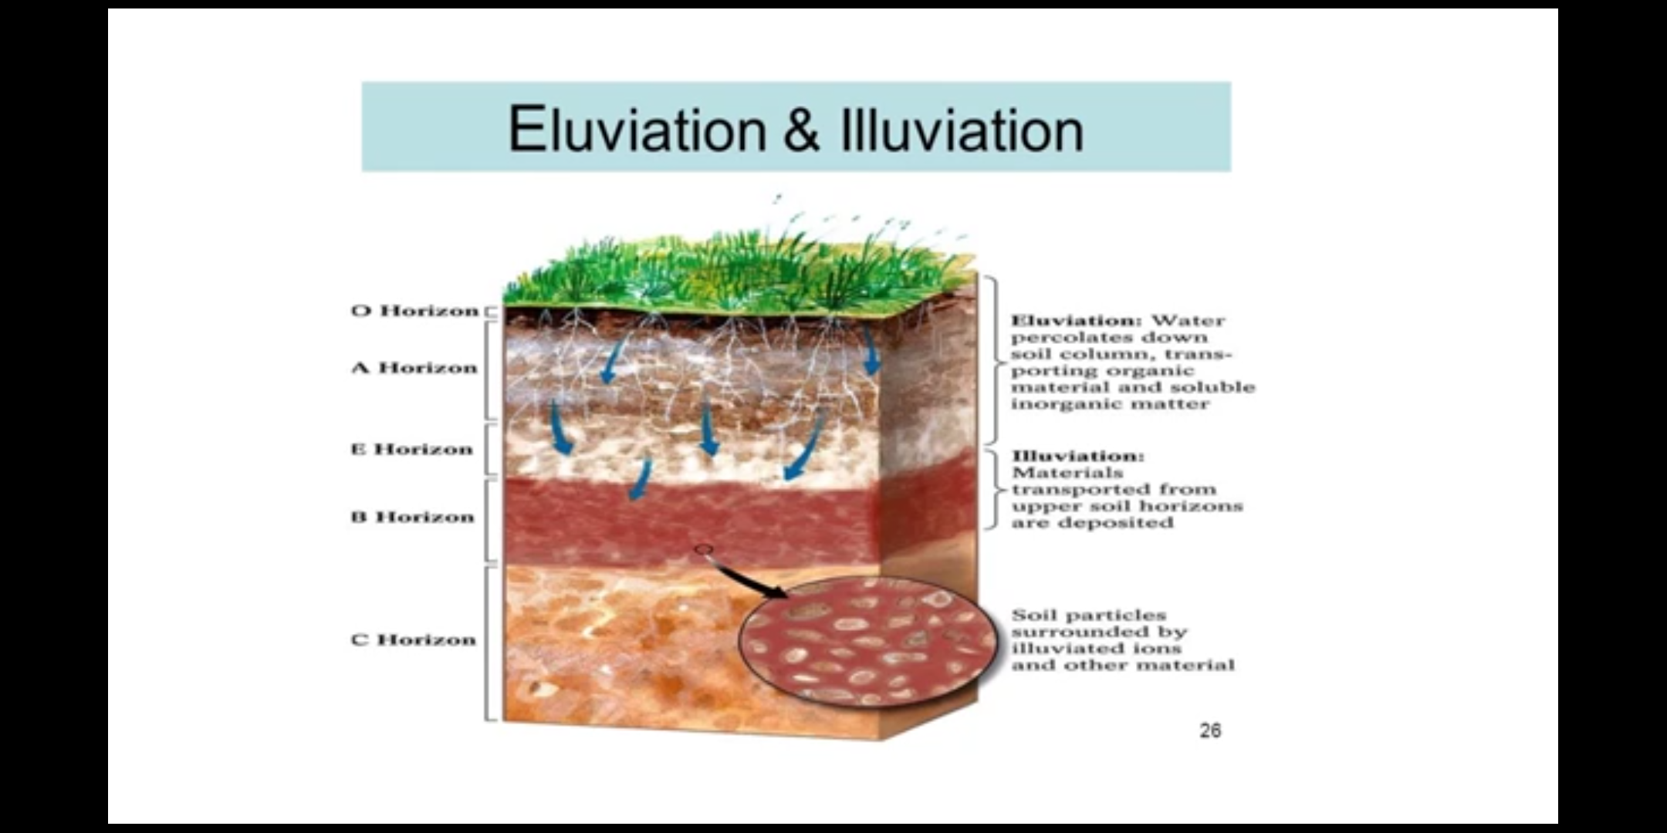

Slide 12
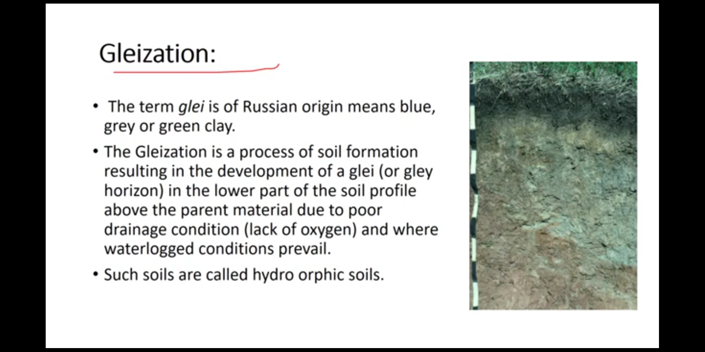

Slide 13
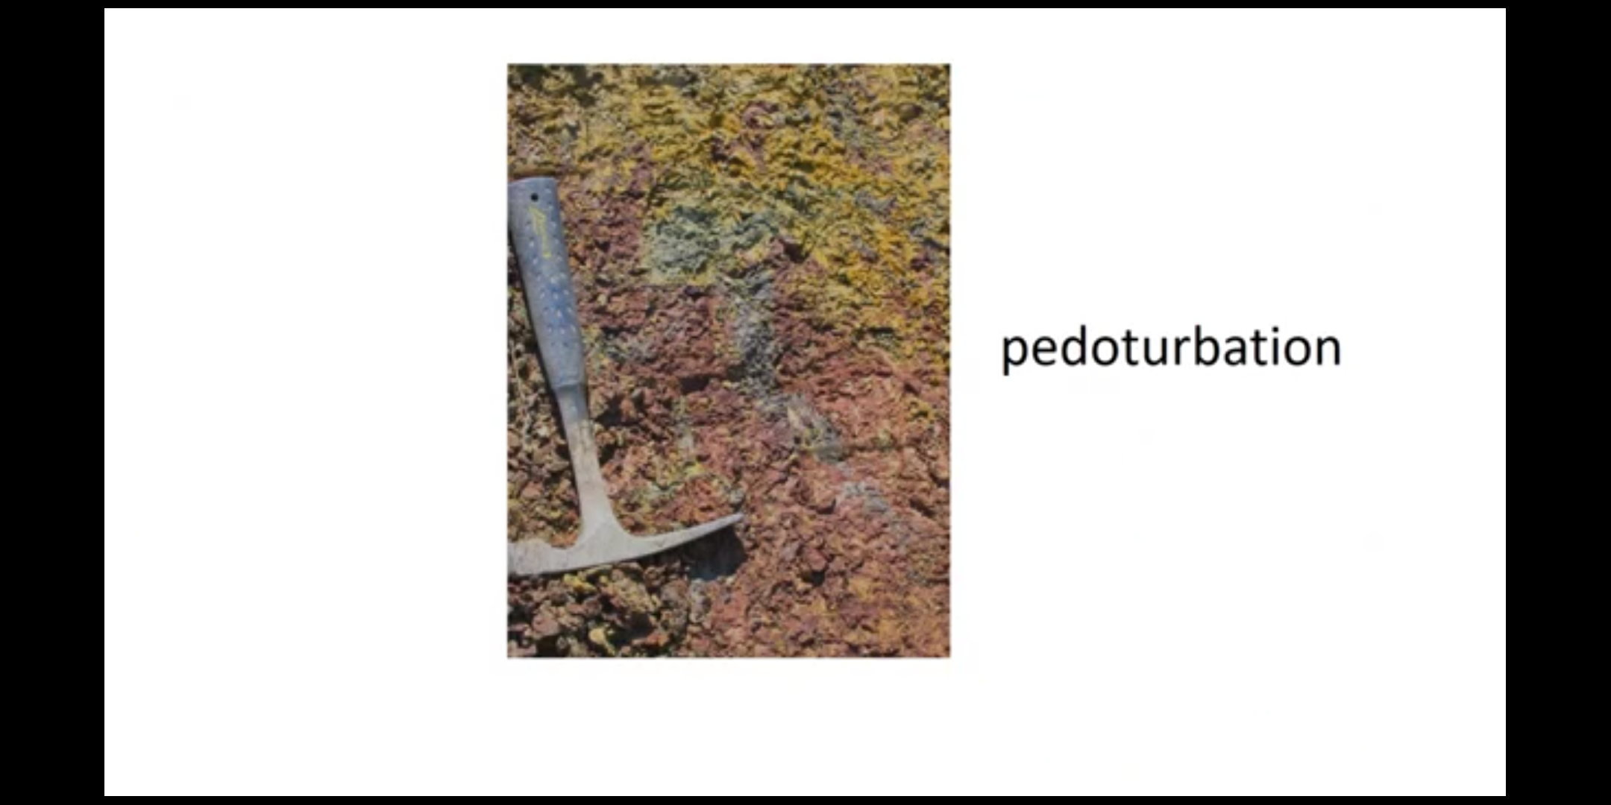

Slide 14
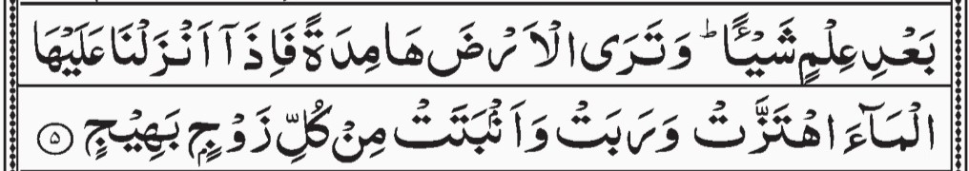
CONCLUSION
Soil is composed primarily of minerals which are produced from parent material that is weathered or broken into small pieces.
There are thousands of different soils throughout the world;

Slide 15
Thank you

